Slide 1


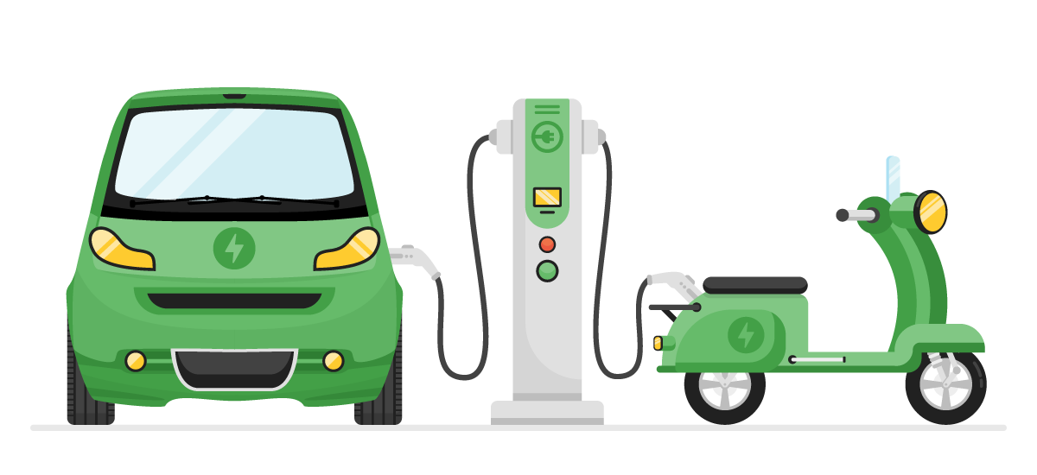
tliQ Motors
Market Research Analysis

Slide 2
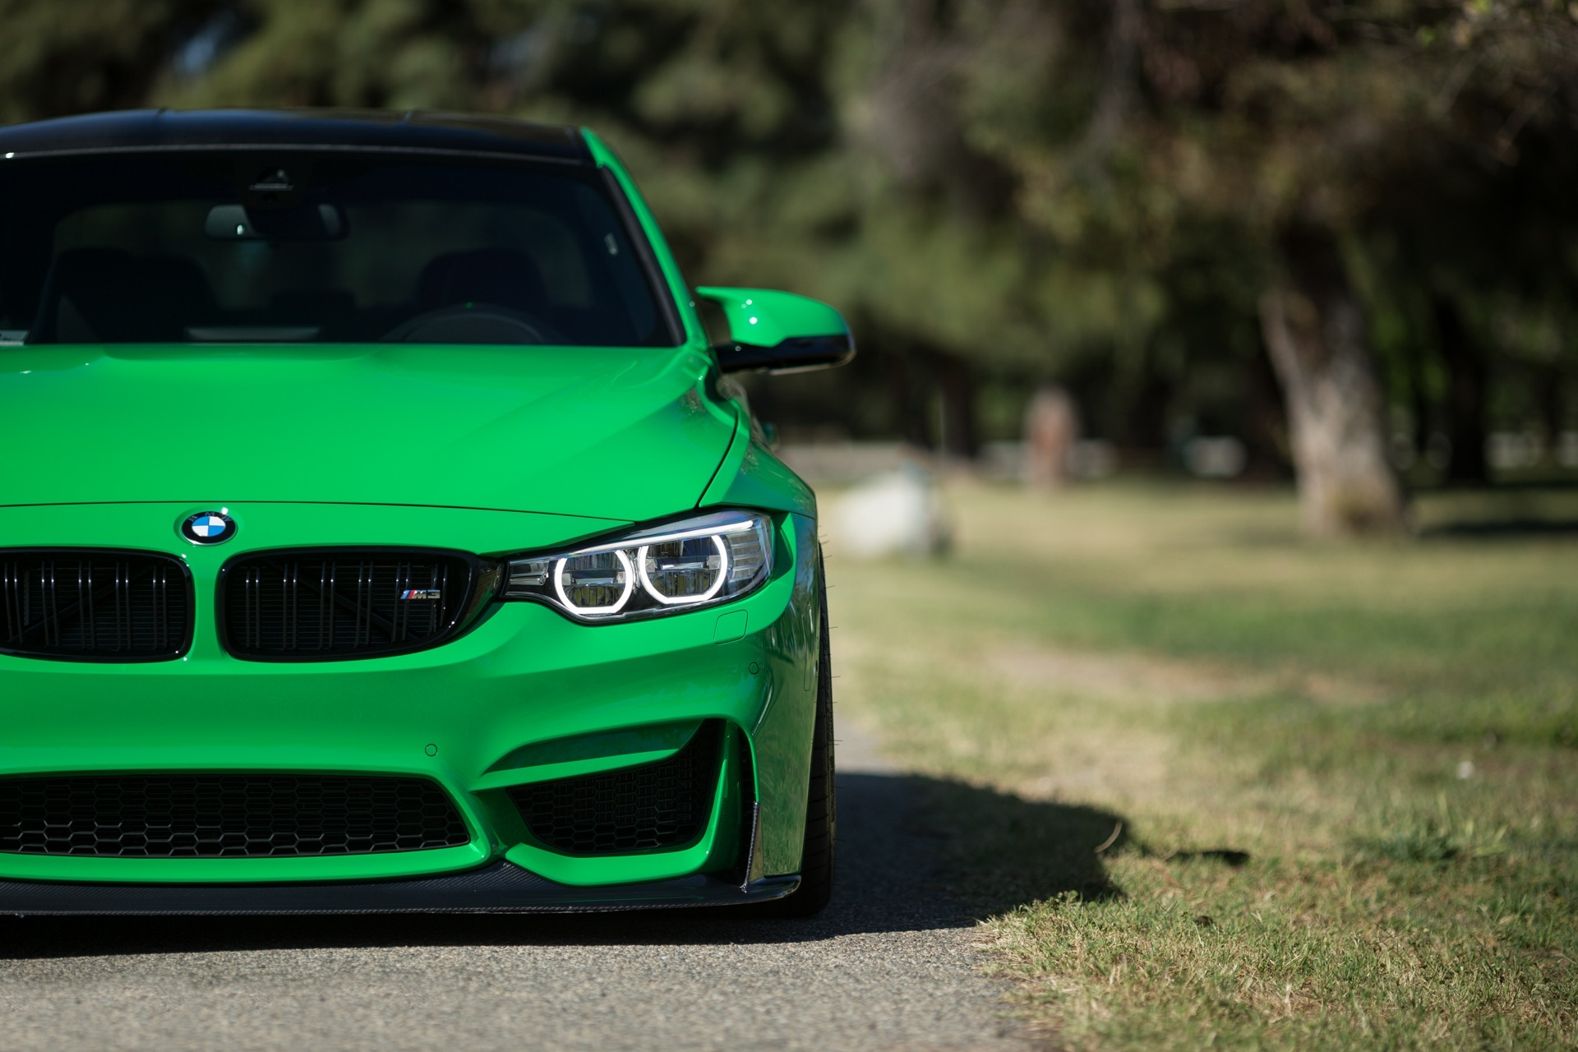
Agenda
1.About Company & Background
2. Input Data Insights
3. Research Questions and Insights
4. Acknowledgments

Slide 3
About Company & Background
Our Company :
AtliQ Motors is a leading automotive company from the USA, specializing in electric vehicles (EV) with a 25% market share in North America's EV and hybrid segment.
AtliQ
Background :
AtliQ Motors aims to expand its presence in India, where its current market share in EVs and hybrids is less than 2%.
Motors
Context :
Bruce Haryali, Chief of AtliQ Motors India, is conducting a detailed market study of the existing EV/Hybrid vehicle market in India to guide the company's expansion plans

Slide 4
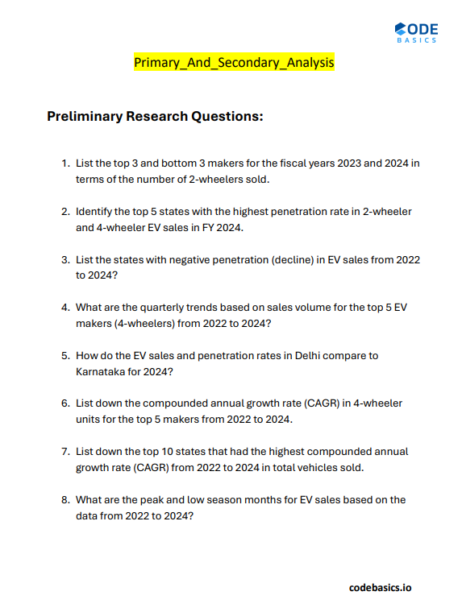
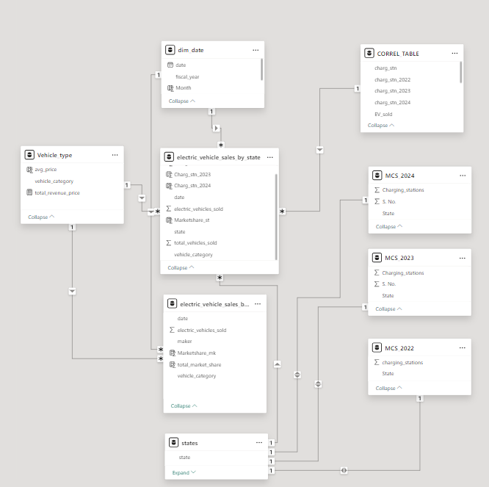
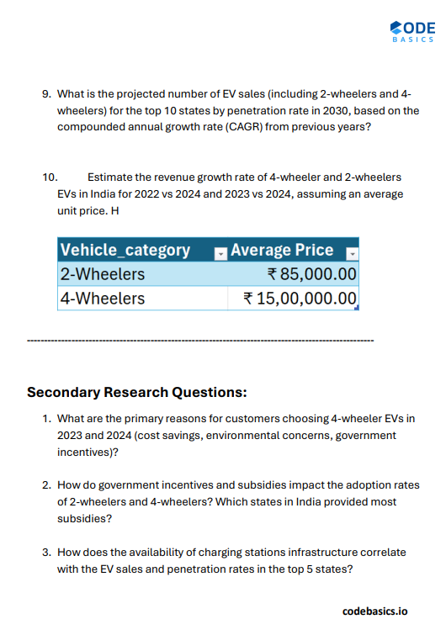
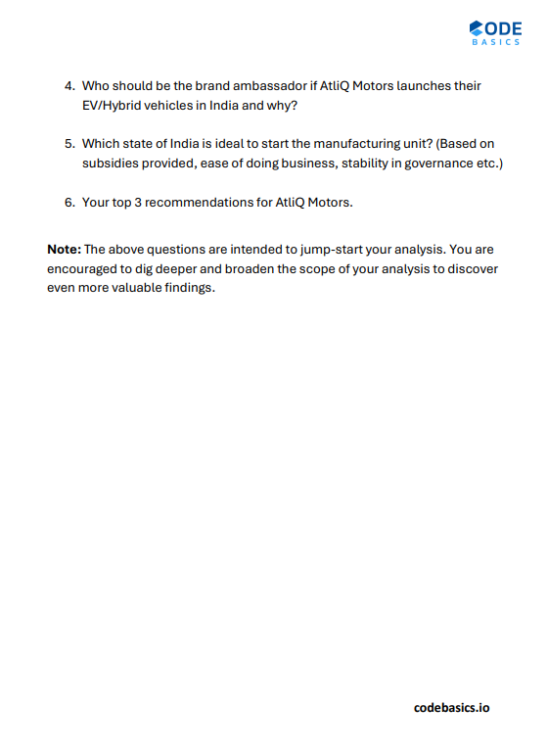
Input Data Insights
Data model

Slide 5
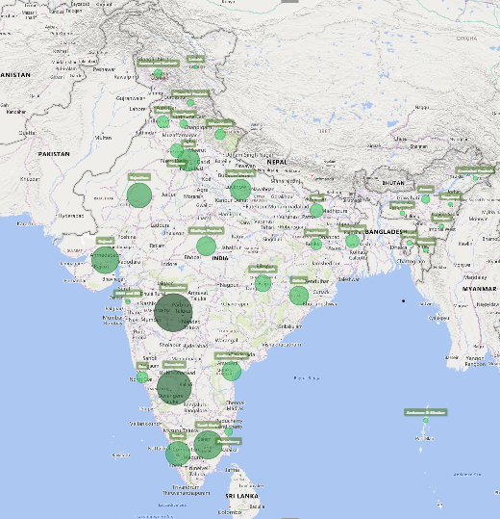
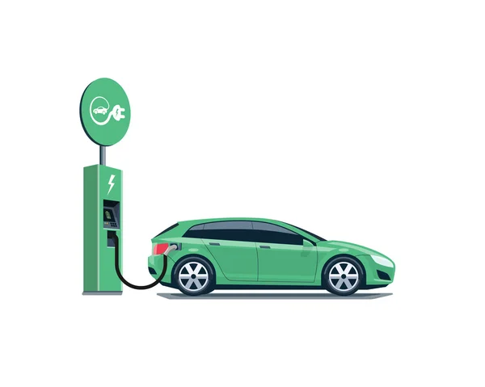
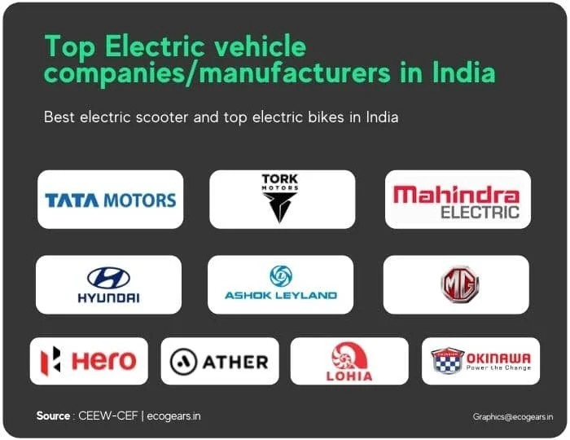
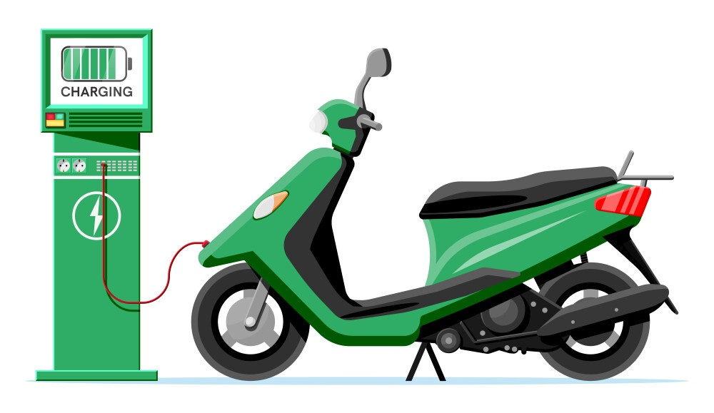
Key Variables
Makers
Vehicle Type
STATE
2 - Wheelers
4 - Wheelers
Penetration Rate %: - Indicates Adoption level of vehicles
CAGR: - measures the mean annual growth rate over a specified period longer than one year.
Fiscal year : Apr 1st to Mar 31st

Slide 6
1.List the top 3 and bottom 3 makers for the fiscal years 2023 and 2024 in terms of the number of 2-wheelers sold.
FY 2023
Competitors
Strategies
Least EV makers are almost starters
Ola Electric : - R & D and Technology Platform - Adoptable Manufacturing and Supply chain platform - D2C omni channel distribution platform
FY 2024
Values are in Thousands

Slide 7
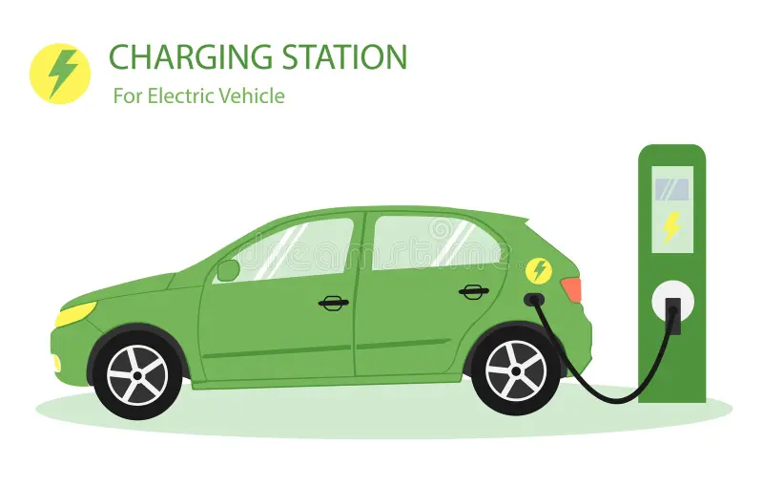
2. Identify the top 5 states with the highest penetration rate in 2-wheeler and 4-wheeler EV sales in FY 2024.
Two Wheelers
Four Wheelers

Slide 8
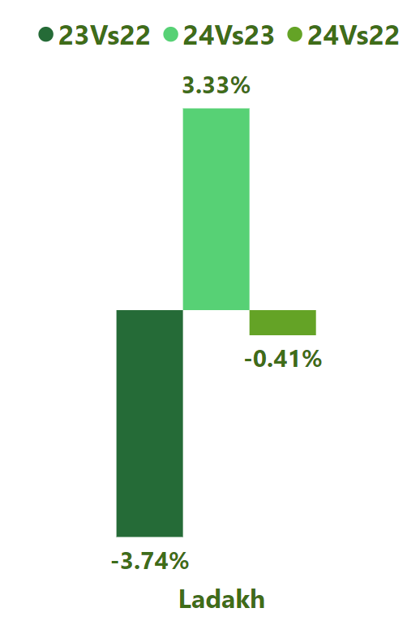
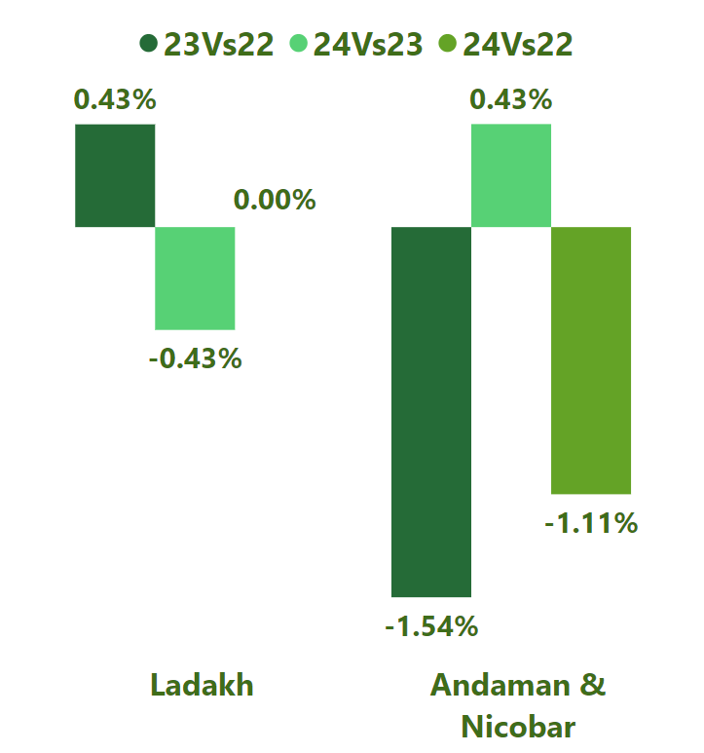
3. List the states with negative penetration (decline) in EV sales from 2022 to 2024?

Slide 9
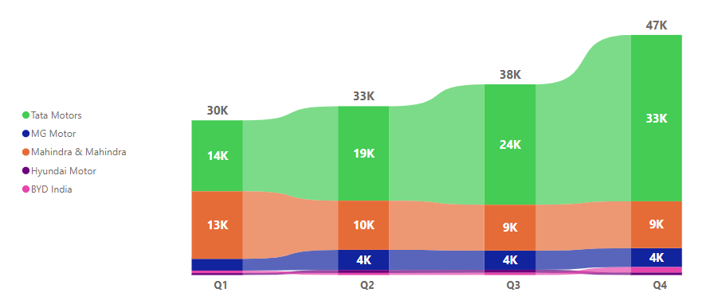
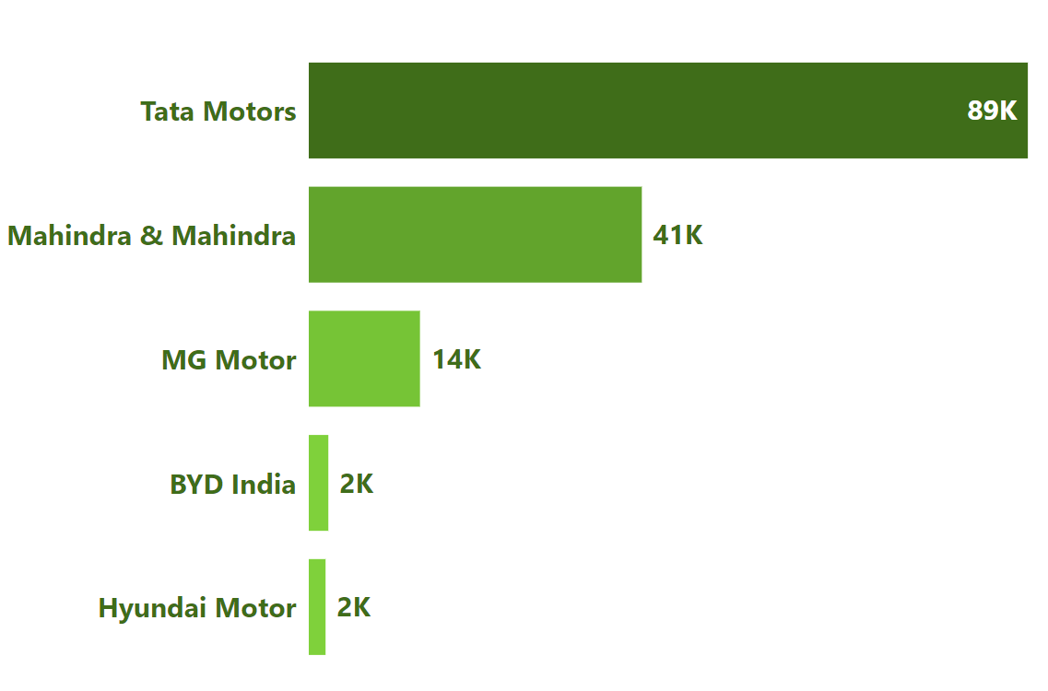
4. What are the quarterly trends based on sales volume for the top 5 EV makers (4-wheelers) from 2022 to 2024?
Maker | Q1 | Q2 | Q3 | Q4
Tata Motors | 13953 | 18581 | 23678 | 32723
MG Motor | 2309 | 3957 | 3766 | 3721
Mahindra & Mahindra | 13286 | 9670 | 9025 | 9212
Hyundai Motor | 392 | 579 | 586 | 519
BYD India | 487 | 423 | 454 | 1055
Higher Sales
4 Wheeler EV sales : 152.94k
Contributing96.7% of Total 4 Wheeler EV sold

Slide 10
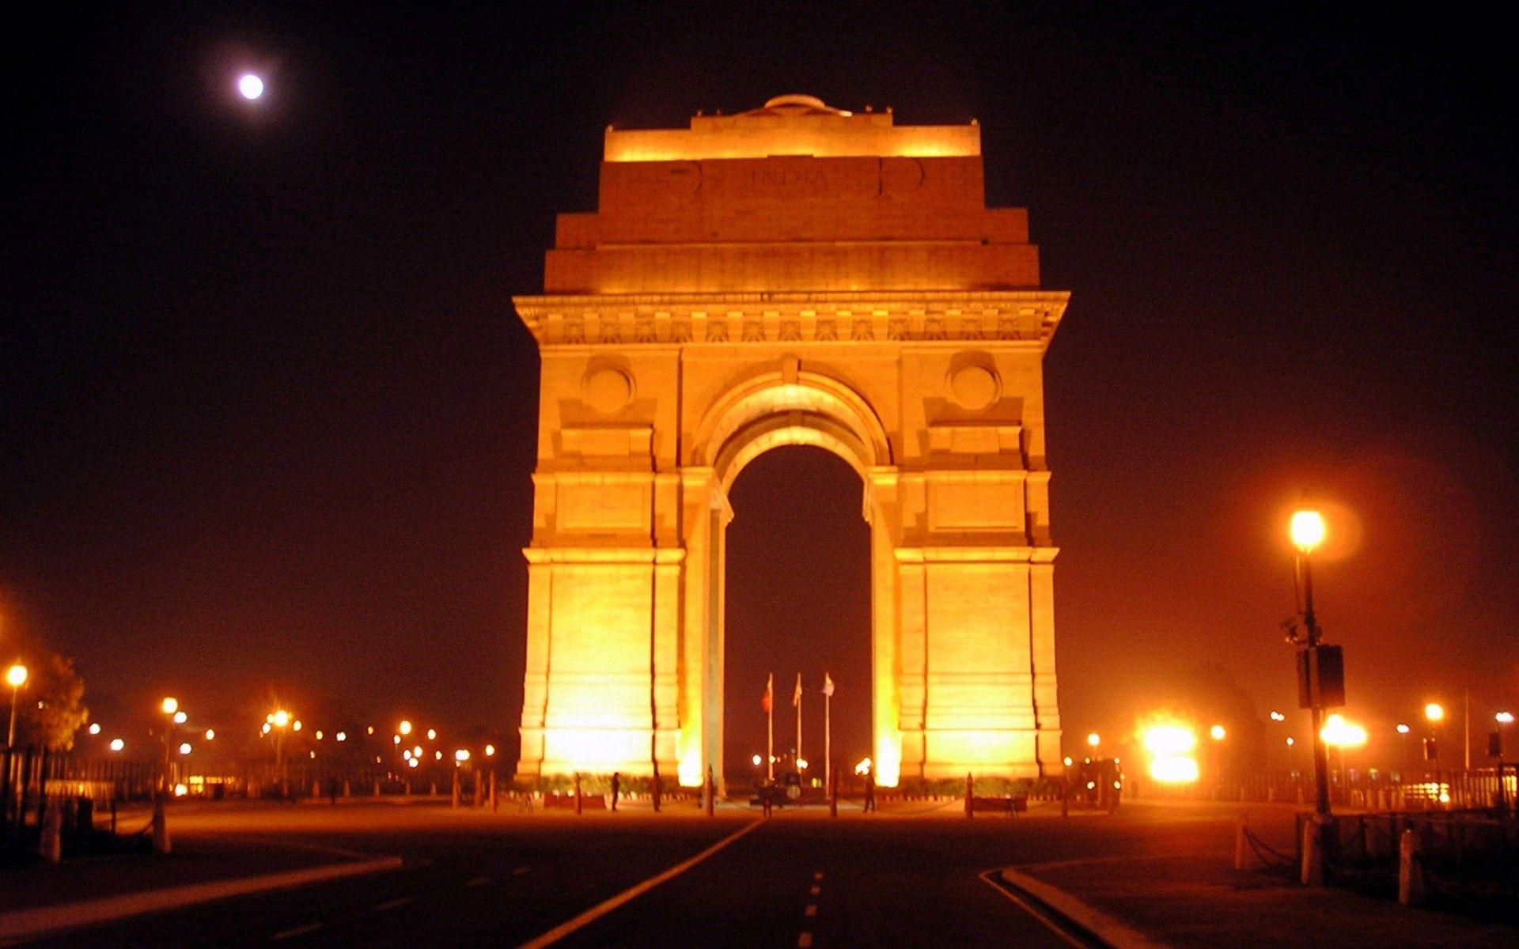

5. How do the EV sales and penetration rates in Delhi compare to Karnataka for 2024?
Karnataka
EV Sales: 46.724K PenetrationRate:7.71%
EV Sales: 160.989K PenetrationRate:10.18%

Slide 11
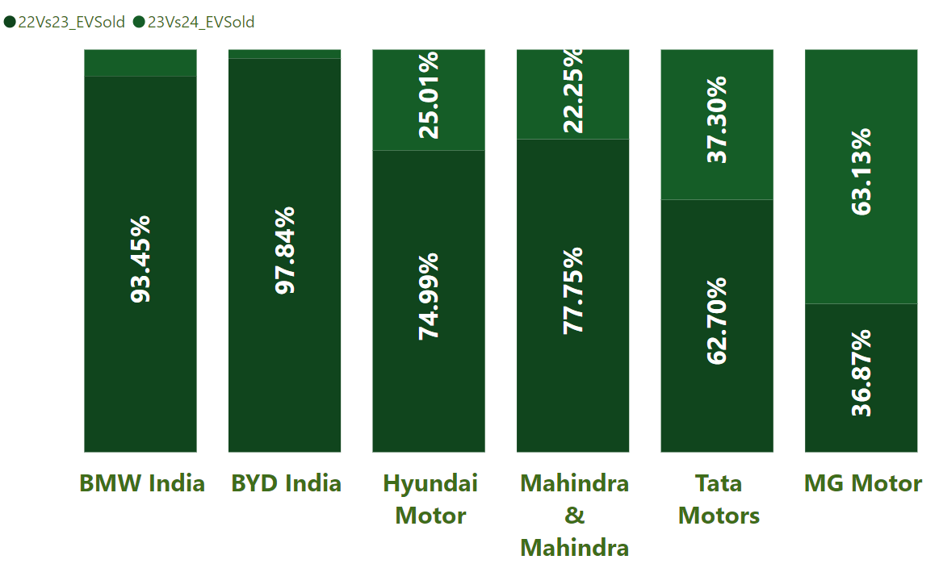
6. List down the compounded annual growth rate (CAGR) in 4-wheeler units for the top 5 makers from 2022 to 2024.
4 Wheeler Top 5 EV Makers
Top 5 CAGR

Slide 12
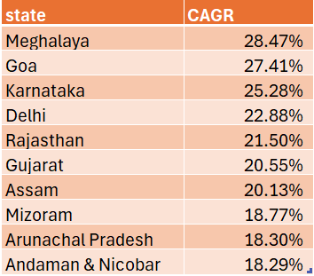
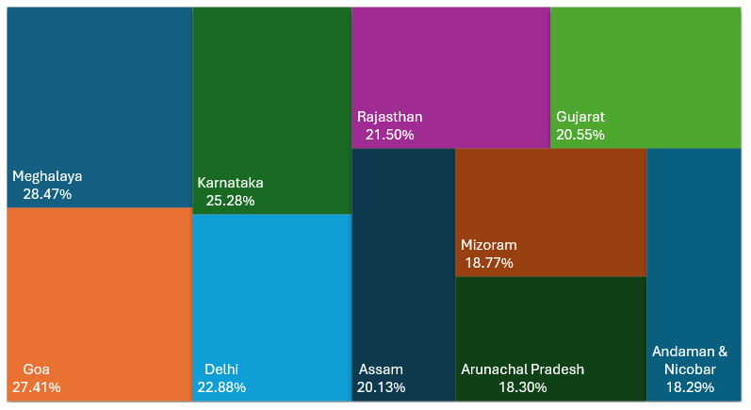
7. List down the top 10 states that had the highest compounded annual growth rate (CAGR) from 2022 to 2024 in total vehicles sold.

Slide 13
8. What are the peak and low season months for EV sales based on the data from 2022 to 2024?
Fiscal year : 2024 EV Sales : 1019.59K
Fiscal year : 2023 EV Sales : 775.37K
Fiscal year : 2022 EV Sales : 271.15K
Least EV sales

Slide 14
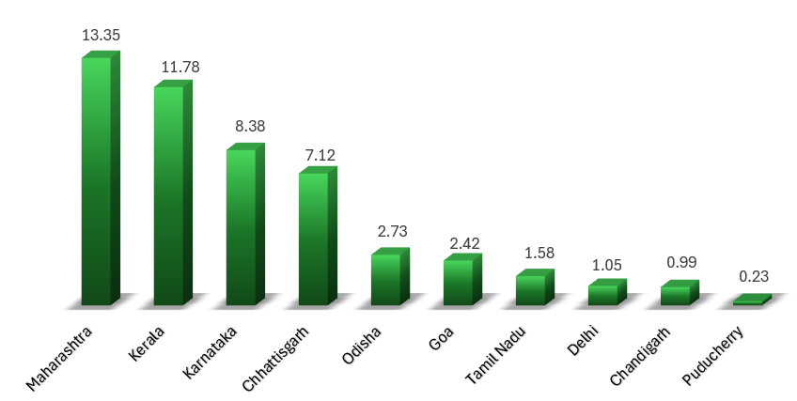
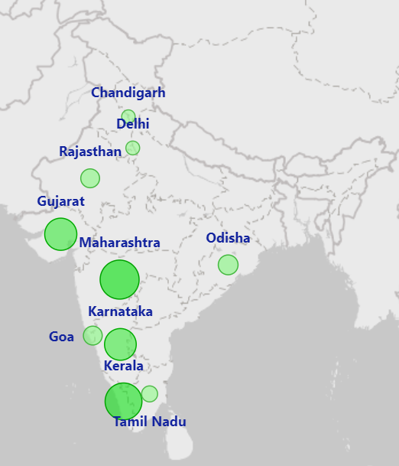
9. What is the projected number of EV sales (including 2-wheelers and 4 wheelers) for the top 10 states by penetration rate in 2030, based on the compounded annual growth rate (CAGR) from previous years?

Slide 15
10. Estimate the revenue growth rate of 4-wheeler and 2-wheelers EVs in India for 2022 vs 2024 and 2023 vs 2024, assuming an average unit price.
2023 vs 2024
2023 vs 2024
28.13%
83.08%
2022 vs 2024
2022 vs 2024
269.28%
367.79%

Slide 16
1. What are the primary reasons for customers choosing 4-wheeler EVs in 2023 and 2024
Cost Savings
Very Low Maintenance cost Electricity prices are stable than petrol
Environmental concerns
EV’s Environment friendly Fossil fuels causes Air pollution and release Greenhouse gases Air pollution – Respiratory diseases
Greenhouse Gases – Global warming and climate change
Government Incentives
PLI FAME schemes are Launches to boost EV adoption Registration fee and Road tax are waived off most of regions

Slide 17
2. How do government incentives and subsidies impact the adoption rates of 2-wheelers and 4-wheelers? Which states in India provided most subsidies?
Incentives and subsidiaries impact on EV
Central Level Incentives - FAME- II (Faster Adoption and Manufacturing Hybrid and Electric vehicles) scheme launches to boost EV adoption
Subsidiaries Provided for boost of 10 lakh Electric Two Wheelers 55K Electric Four Wheelers
Subsidiaries for - 2 –Wheelers – 15000 kwh and max cap on subsidy raised to 40% in 2024 - 4 – Wheelers – 10000 kwh and Maximum incentive amount up to 1.5 lakh per vehicle
States with Most Subsidiaries
Gujarat - Max incentive 1.5 lakh per vehicle
Maharashtra – Max Incentive 2.5 lakh per vehicle
Meghalaya – Max Incentive 60000 per vehicle

Slide 18
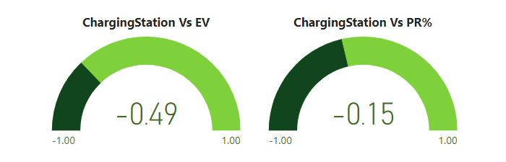
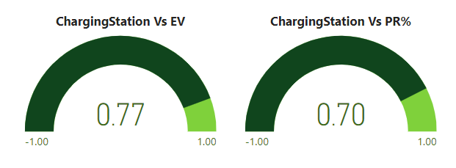
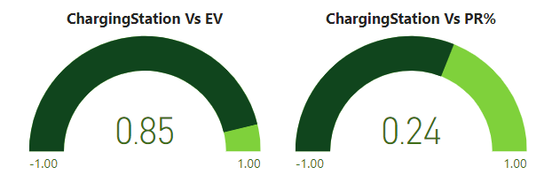
3. How does the availability of charging stations infrastructure correlate with the EV sales and penetration rates in the top 5 states?
2022
2023
2024

Slide 19

4. Who should be the brand ambassador if AtliQ Motors launches their EV/Hybrid vehicles in India and why?
Popularity: Virat Kohli is one of India's most popular and influential sports figures, with a massive following across different demographics. Fitness and Sustainability Image: He is known for his fitness regime and recently adopted a more eco-friendly, sustainable lifestyle, aligning with the green and clean energy ethos of electric vehicles (EVs). Youth Appeal: As a youth icon, he can resonate well with younger audiences who are more inclined towards EVs and sustainability. Credibility: Kohli has been part of premium and reliable brands, which adds credibility to the product.

Slide 20
5. Which state of India is ideal to start the manufacturing unit?
Maharashtra Subsidies: Maharashtra offers significant subsidies under its EV policy, including incentives for setting up manufacturing units, waivers on registration charges, and interest subsidies on loans.
Ease of Doing Business: It consistently ranks high in the Ease of Doing Business Index and offers a favorable industrial climate.
Infrastructure: Maharashtra has good connectivity with road, rail, and sea, especially with cities like Mumbai and Pune being automotive hubs.
Governance Stability: Maharashtra has a relatively stable political climate and a government committed to promoting clean energy and EVs.
Gujarat
Subsidies: Gujarat's EV policy provides subsidies for setting up EV and battery manufacturing plants, reduced power tariffs, and incentives for R&D.
Ease of Doing Business: Gujarat is known for its business-friendly environment and has topped rankings for ease of doing business.
Infrastructure: It has well-developed industrial zones and good port facilities for exports, making it ideal for large-scale manufacturing.
Governance Stability: Gujarat has a stable government and a pro-industry stance, which is crucial for long-term investments.

Slide 21
6. Your top 3 recommendations for AtliQ Motors.

Slide 22
Acknowledgments

